Slide 1
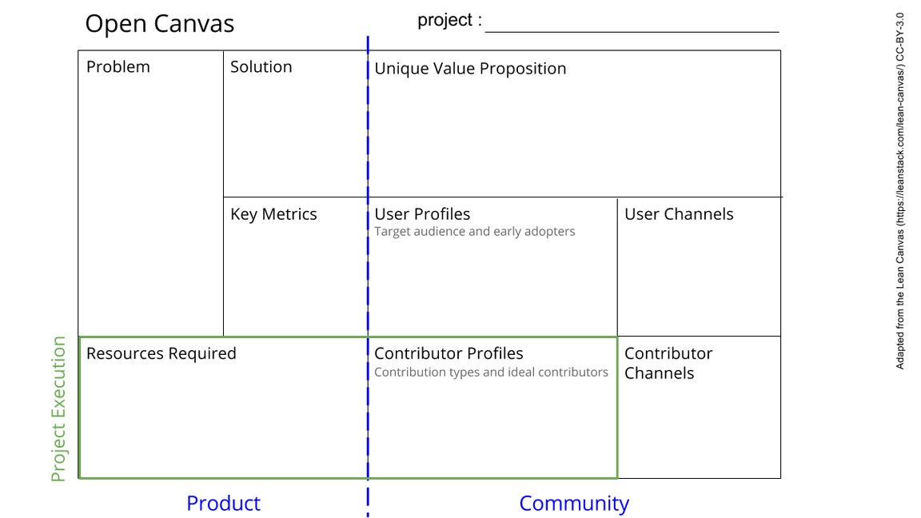
AMRITA - an online database for herbal medicine
Herbal medicine in South East Asia is not standardized.
Research culture in SE region does not advocate collaboration.
Create a platform where researchers in herbal medicine are collected and organized.
Introduce openness in research through online database
The first organized database for herbal medicine accessible by all
Intersection for researchers, clinicians and private sectors
Promotion of openness and sharing culture in South East Asia
Number of users and contributors of the database
Public advertisement (conferences, seminar, social media, etc)
Researchers, clinicians, drug companies and general public
A web domain
Programming skills for database construction
An appealing and welcoming design for users
Contributors who register their study on the database
Maintenance cost
Researchers who work on herbal medicines and are willing to share their studies to the community
Programmers
Public advertisement (conferences, seminar, social media, etc)
Data uploaded by registered contributors
See next slide for instructions!
Notes:
Go to File > Make a Copy… to make your own canvas
See next slide for instructions

Slide 2
